Slide 1

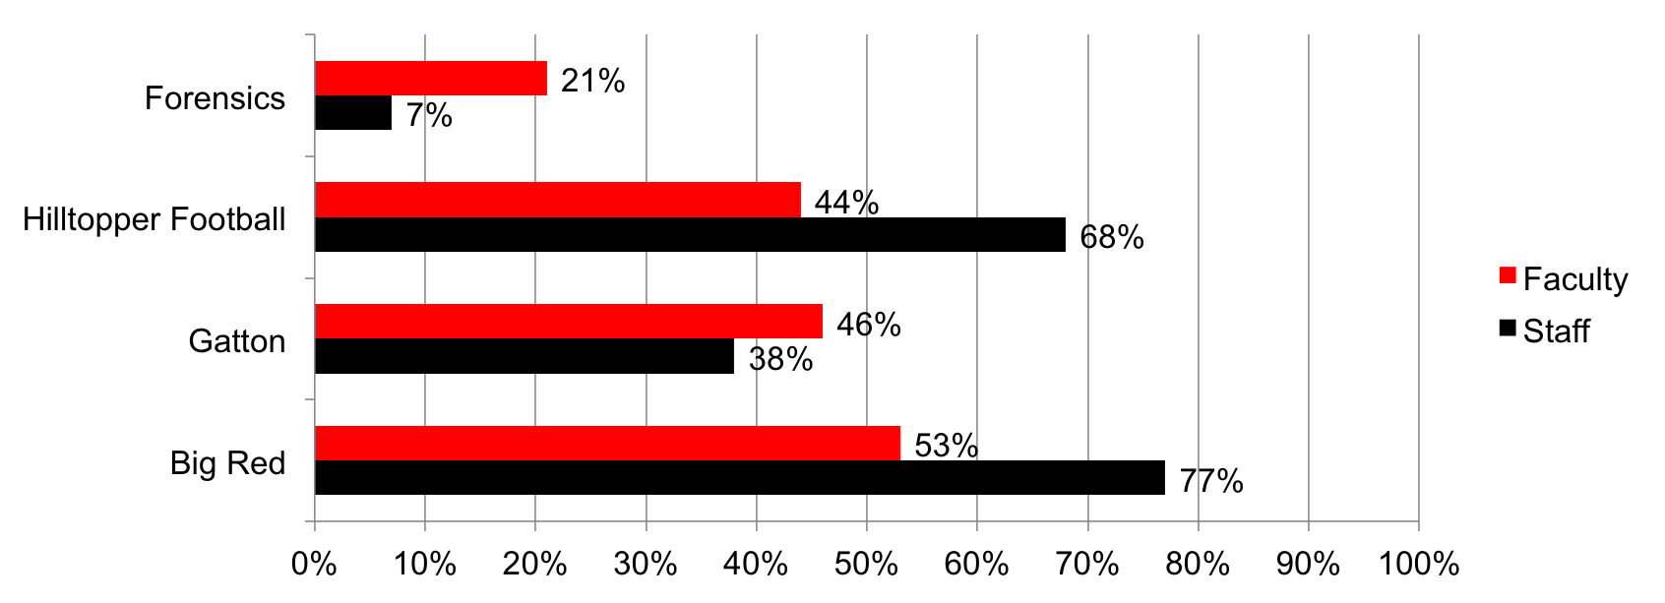
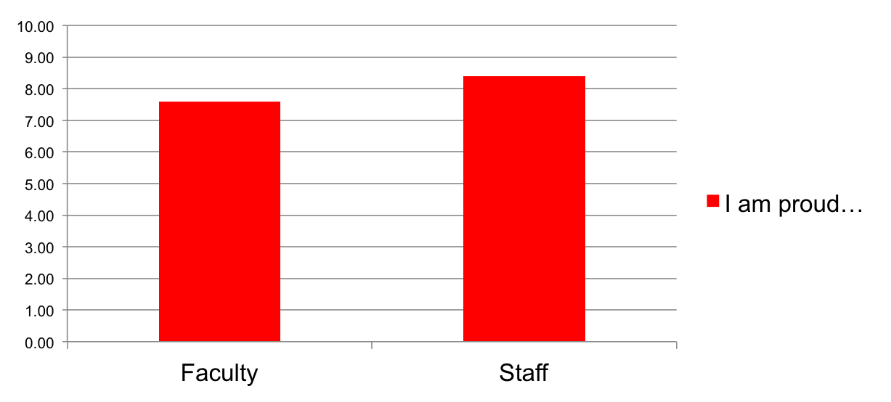
Communication Goals of American Universities: A Social Media Conent Analysis
Travis Ryan, Department of Political Science & Honors College, Western Kentucky University
Scott Lasley, Department of Political Science, Western Kentucky University
Research Question
Results Cont.
Findings
General Question:
To what degree are universities tweeting about academics, athletics, and the arts?
Specific Questions:
Are schools with less athletic prestige communicating more about athletics on social media?
To what extent do the following enhance the reputation of WKU as an institution?
A divide emerges between how faculty and staff view intercollegiate athletics and the benefits of athletics to an institution
A divide will also exist between faculty and the broader community If staff are a good reflection of the broader community
Staff generally prouder to be at WKU than faculty
Sports and other athletics symbols and venues were greater source of price for staff than faculty
differences on academic items often not significant
When asked about WKU’s reputation being enhanced, the findings are similar
Staff more supportive of move to FBS football and the decision to join Conference USA
Decision to cut men’s soccer and men’s tennis
Faculty were more likely to know that revenues from college athletics do not cover athletics expenses.
Regression analysis also highlights a couple of other patterns.
Faculty and Staff who are alumni of WKU gave more positive responses across almost all questions.
Gender differences do emerge on many of the questions.
 | Faculty | Staff | Stat. Sig.
Big Red Mascot | 5.25 | 7.23 | 0.001
Downing Student Union | 4.86 | 6.04 | 0.001
E. A.Diddle Arena | 4.39 | 5.90 | 0.001
Hilltopper Football | 5.03 | 7.00 | 0.001
Forensics | 7.19 | 6.94
Gatton Academy of Arts & Sciences | 7.90 | 8.05
Honors College | 6.55 | 7.04 | 0.05
Men’s Basketball | 4.58 | 5.93 | 0.001
WKU Department of Theater | 5.56 | 5.68
Women's Basketball | 4.74 | 6.06 | 0.001
Research Design
Conducted online survey of WKU faculty and staff
Staff serve as proxy for community (Kelly, Vidal, Burden 2016)
649 started the survey, approximately 580 completed it
Survey addressed faculty and staff attitudes related to:
Factors that made them feel proud to work at WKU
Factors that enhance the reputation of WKU as an institution
WKU topics that people discuss with faculty and staff
Whether WKU places appropriate emphasis on athletics & academics
Degree of agreement with decisions made by the administration regarding athletics at WKU
When you tell people who have not attended or worked at WKU that you work here, which of the following items are they most likely to mention?
Future Directions for Research
Time Line of Changes in Intercollegiate Athletics at Western Kentucky University
Survey local community
Measure to what extent staff reflect community sentiment
Compare University community to broader community
Survey faculty at other universities and compare to WKU faculty to determine if findings are context specific
Survey WKU students to determine if there is a gap between faculty and student attitudes on intercollegiate athletics on campus
Determine if students know the true cost of athletics
2006 – Vote to move to FBS (D1-A) football (ESPN.com News Services)
2008 – Men’s Soccer dropped (Kennedy)
2014 – All teams move to Conference USA (Aulbach)
2014 – Men’s Tennis dropped (Herald Sports Staff)
2015 – Swimming and Diving teams suspended for 5 years (Rogers and Crumbie)
Whether they agree or disagreed with decisions made by the administration regarding athletics at WKU?
 | Faculty | Staff | Stat. Sig
Moving to FBS had positive impact on WKU as an academic institution | 34% | 60% | 0.001
Moving up had a positive impact on athletics | 49% | 65% | 0.001
Moving has increased visibility to WKU | 68% | 81% | 0.001
Move to Conference USA has had a positive impact on WKU | 40% | 59% | 0.001
Support to decision to eliminate men’s soccer | 12% | 15%
Support decision to drop men's tennis | 12% | 16%
Support decision to suspend swimming | 42% | 49% | 0.1
Move to FBS football has increased pride | 23% | 41% | 0.001
Works Cited
Results
Aulbach, Lucas. WKU Herald. 1 April 2013, http://wkuherald.com/news/wku-approves-move-to-conference-usa/article_8deeeae0-9aed-11e2-9321-001a4bcf6878.html . Accessed 20 March 2017.
ESPN.com news services. ESPN. 2 Nov. 2006, http://www.espn.com/college-football/news/story?id=2647510 . Accessed 20 March 2017.
Herald Sports Staff. WKU Herald. 29 April 2014, http://wkuherald.com/sports/wku-men-s-tennis-program-discontinued-due-to-budget-cuts/article_a375347c-cfea-11e3-848e-001a4bcf6878.html . Accessed 20 March 2017.
Kelly, D., Vidal, L. and Burden, B. C. (2016), A Convenient Truth: University Employees as Heterogeneous and Inexpensive Experimental Samples*. Social Science Quarterly. doi:10.1111/ssqu.12336
Kennedy, Paul. Soccer America. 8 Feb. 2008, https://www.socceramerica.com/article/25484/western-kentucky-drops-mens-soccer.html . Accessed 20 March 2017.
Rogers, Shelby, and Trey Crumbie. WKU Herald. 15 April 2015, http://wkuherald.com/news/hindsight-wku-suspends-swim-team-for-five-years/article_e8628da2-e3c4-11e4-b658-fb750cc0e2e7.html . Accessed 20 March 2017.
I am proud to be a faculty or staff member at WKU
Whether WKU places too much, too little or about the right amount of emphasis on athletics, academics, and the arts?
 | Faculty | Staff | Stat. Sig
Too Much Emphasis on Athletics? | 67% | 48% | 0.001
Too Little on Academics | 82% | 54% | 0.001
Too Little on the Arts | 55% | 44% | 0.01
Know that Athletics does not generate positive net revenue? | 61% | 42% | 0.001
To what extent do the following make you proud to be a faculty or staff member at WKU?
 | Faculty | Staff | Stat. Sig.
Big Red (University Mascot) | 4.98 | 7.04 | 0.001
Downing Student Union | 5.59 | 6.67 | 0.001
E. A. Diddle Arena | 4.69 | 6.25 | 0.001
Hilltopper Football | 4.60 | 6.44 | 0.001
Forensics | 6.93 | 6.51
Gatton Academy of Math and Science | 7.19 | 7.49
Honors College | 6.12 | 6.61 | 0.1
Men’s Basketball | 4.36 | 5.56 | 0.001
WKU Department of Theater | 6.05 | 5.90
Women's Basketball | 4.87 | 6.09 | 0.001
Title IX
56% of respondents indicated that they know a great deal about how Title IX impact intercollegiate athletics.
62% indicated that title IX had a positive impact on intercollegiate athletics.
53% of respondents indicated that Title IX has been a controversial issue in college sports, but only 33% see it as controversial at WKU. Only 18% of respondents indicated that men’s sports had been hurt by Title IX, while 59% believe that women’s sports could use more resources.
80% of respondents know that Title IX applied to Gender/Sex but 20% believed that it also applied to Race.
Contact Information
Scott Lasley
scott.lasley@wku.edu
Department of Political Science
Potter College Arts & Letters
Brad Stinnett
brad.stinnett@wku.edu
School of Kinesiology, Recreation & Sport
College of Health & Human Services
© 2011 Western Kentucky University. Printing paid from state funds, KRS 57.375
Western Kentucky University is an equal opportunity institution of higher education and upon request provides reasonable accommodation to individuals with disabilities. www.wku.edu/eoo

